Slide 1
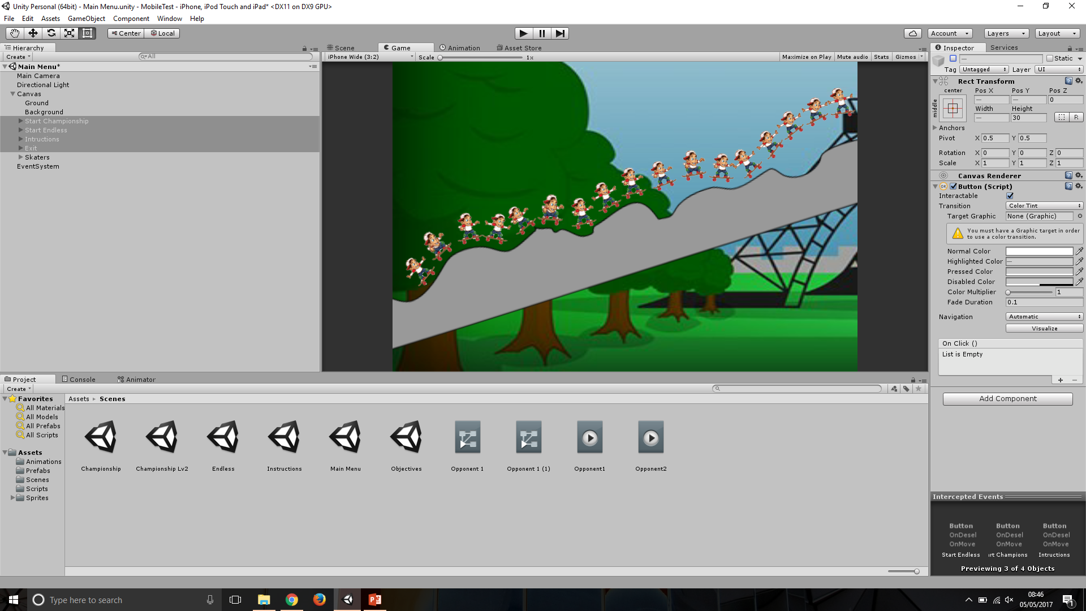
Skating ‘n’ Racing
Professional and Entrepreneurial Portfolio
Tom Robinson

Slide 2
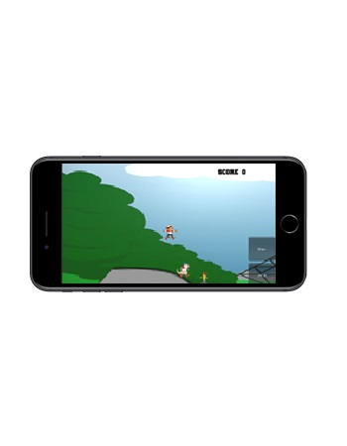
What is it?
A game created with the mobile platform in mind
A racing game in which you are aiming to become the world champion of downhill skating!
Aimed for a wider target audience than just skaters!
Two game modes for double the fun
Championship
Endless

Slide 3
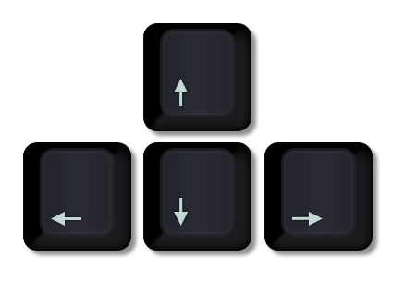
How to play!
Component
Rotation of Player
Ollie
Shuv-it
Menu Controls
PC
Left / Right arrows
Up arrow
Down arrow
Mouse control
Mobile
Rotation of device using internal gyroscope
On screen button
On screen button
Touch screen

Slide 4

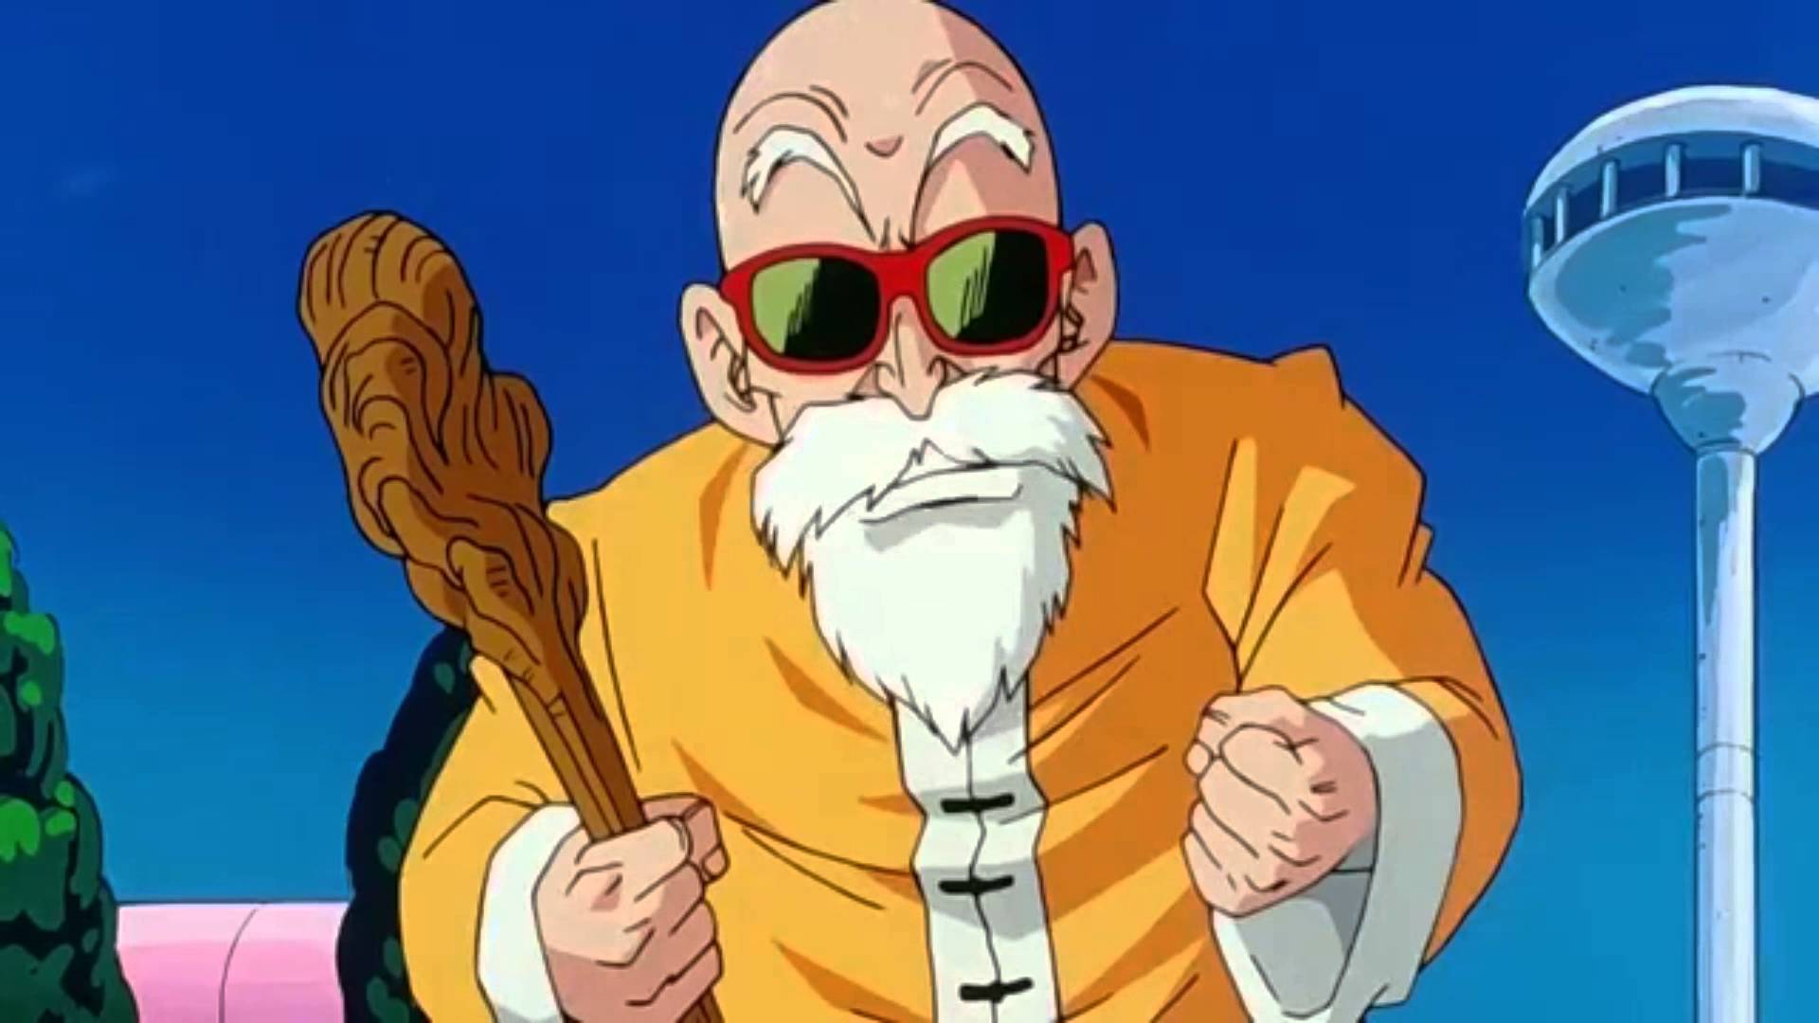
Focus
This game was created to display my skills as a programmer
Due to this fact most assets have been gathered from online sources and edited to my needs
Main personal asset creation involves development of track

Slide 5
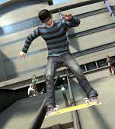
Design
Bike Racer meets Skate
Set in a semi-realistic world
‘Cartoony’ assets to appeal to younger audience
Score points by completing tricks / flips

Slide 6


Championship
Within this game mode you will be racing against other competitors to become the champion of downhill skating
Three levels ‘set’ in different locations across the world
Overall position among competitors displayed after final race to show position in the championship

Slide 7
Endless
Within this game mode the objective is to keep going for as long as possible
Fail state enabled if crashed ground object or if the timer, counting down from 30 seconds, reaches 0. Acting as a stamina of the skater.
Can pick up objects, with skins portraying energy drinks / food to increase stamina / timer if collected.

Slide 8
Thanks for listening!
Q&A

